Slide 1
2013 Product Line Up
Cresyn Co.,Ltd.

Slide 2
Table of Content
Part 1. 2012 Line Up
[1] Earphone (Open / Canal)
[2] Headphone / Earset / Headset
Part 2. 2013 Line Up (New)
[1] Earphone / Headphone / Earset / Headset
Part 3. Positioning & Time Table
[1] Earphone / Earset
[2] Headphone / Headset

Slide 3
Part 1. 2012 Line Up

Slide 4
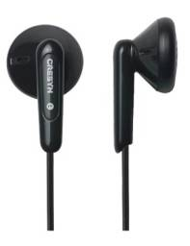
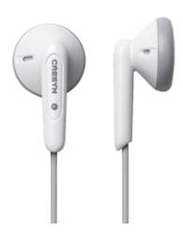
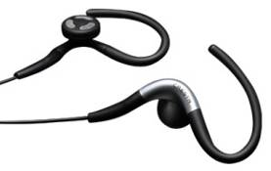
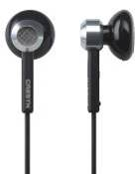
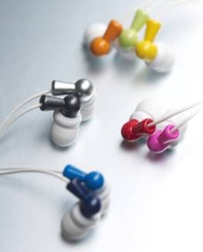
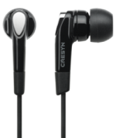
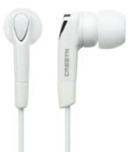
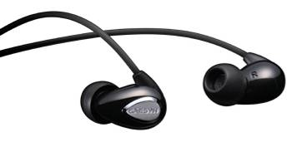
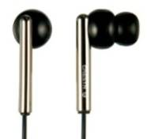
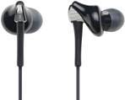
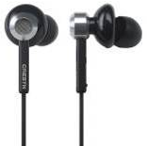
[1] Earphone (Open / Canal)
Earphone
(Open)
CS-EP200
Rubby Dubby (C190E)
C220E
AXE 4
C500E
Volume driver
Royal & Classic driver
Earphone
(Canal)
C230E
Petite Buddy (C222E)
Bijoux (C410E)
C330E
Volume driver
Fashion & Volume driver
Unique & Fashion driver
AXE (C415E)
Staccato (C412E)
C260E
LMX-E630
C510E
Volume driver
Royal & Classic driver

Slide 5
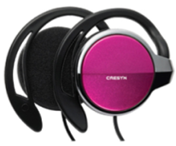
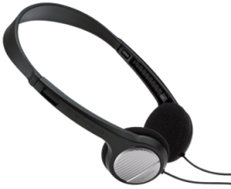
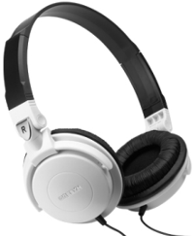
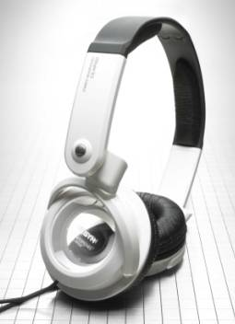
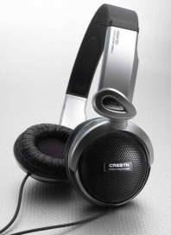
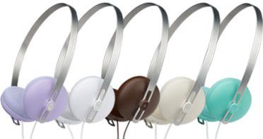
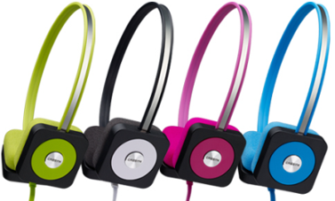
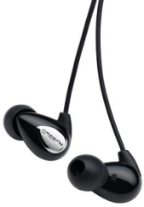
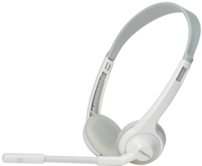
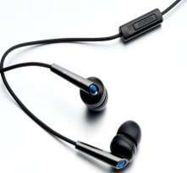
[2] Headphone / Earset / Headset
Headphone
AXIS (C555H)
CS-CH300
C200H
C510H
Clip Sports Gear
Volume driver
Royal & Classic driver
Pastel (C300H)
Disc (C515H)
CS-HP500
CS-HP600
Unique & Fashion driver
Image driver
(Cresyn’s Representative)
Royal & Classic driver
Earset &
Headset
AXIS (C555S)
C360S
C230S
C262S
C201S
Volume driver
Royal & Classic driver
Volume driver
Notes:
4

Slide 6
Part 2. 2013 Line Up (New)
Cresyn - proprietary and confidential
[1] Open Earphone / Canal Earphone
[2] Headphone / Earset & Headset

Slide 7
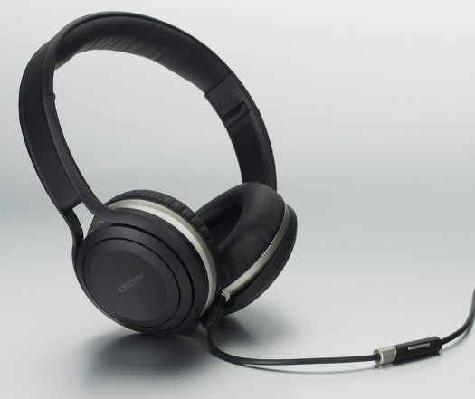
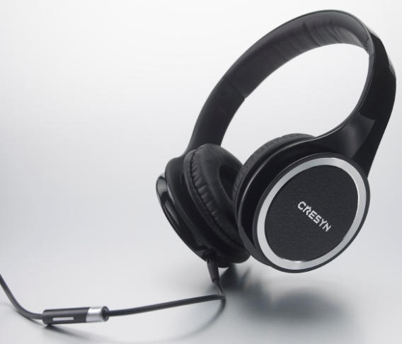
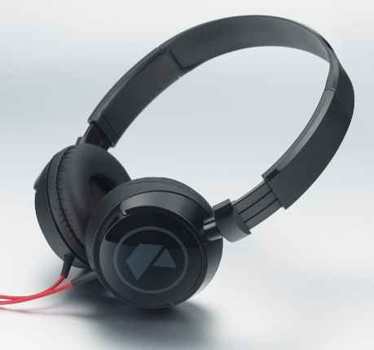
[1] Earphone / Headphone / Earset / Headset
Earphone &
Headphone
C520E
C590H
C750H
Royal & Classic driver
Image driver
Royal & Classic driver
Earset &
Headset
C250H
Volume driver
Notes:
6

Slide 8
Part 3. Positioning & Time Table
Cresyn - proprietary and confidential

Slide 9
[1] Earphone / Earset
Cresyn Value Up
C500E
C510E
High-end
C520E
AXE (C415E)
Staccato (C412E)
Middle-end
Bijoux (C410E)
C230S
C262S
AXE 4
C220E
Low-end
C360S
LMX-E630
C260E
Rubby Dubby (C190E)
Petite Buddy (C222E)
CS-EP200
C330E
C230E
2012
2013

Slide 10
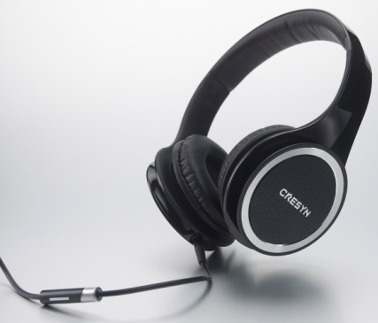
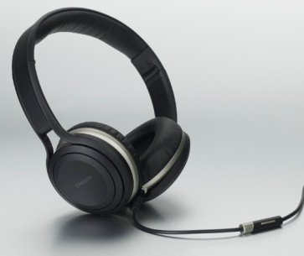
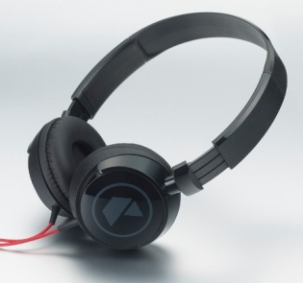
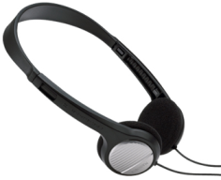
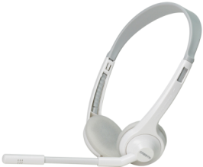
[2] Headphone / Headset
Cresyn Value Up
High-end
C750H
AXIS (C555H)
AXIS (C555S)
C590H
Middle-end
CS-HP600
CS-HP500
Disc (C515H)
Pastel (C300H)
C250H
C510H
Low-end
CS-CH300
C200H
C201S
2012
2013

Slide 11
감사합니다 !
Danke !
Delgrado !
謝 謝 !
Gracias !
Thank you !
Grazie !
Dank U !
Terima Kasih !
ありがとうございます!
Спасибо !
Merci !
ขอบพระคุณครับ !

